Slide 1
Topic 1: What’s topdown approach and how to apply it
CHALLENGE 0
Name: Tran Trung Hieu

Slide 2
TABLE OF CONTENTS
01
What is Top-Down approach?
02
The Top-Down approach advantages and disadvantage
03
When to use the Top-Down approach?
04
How to apply the Top-Down approach?

Slide 3
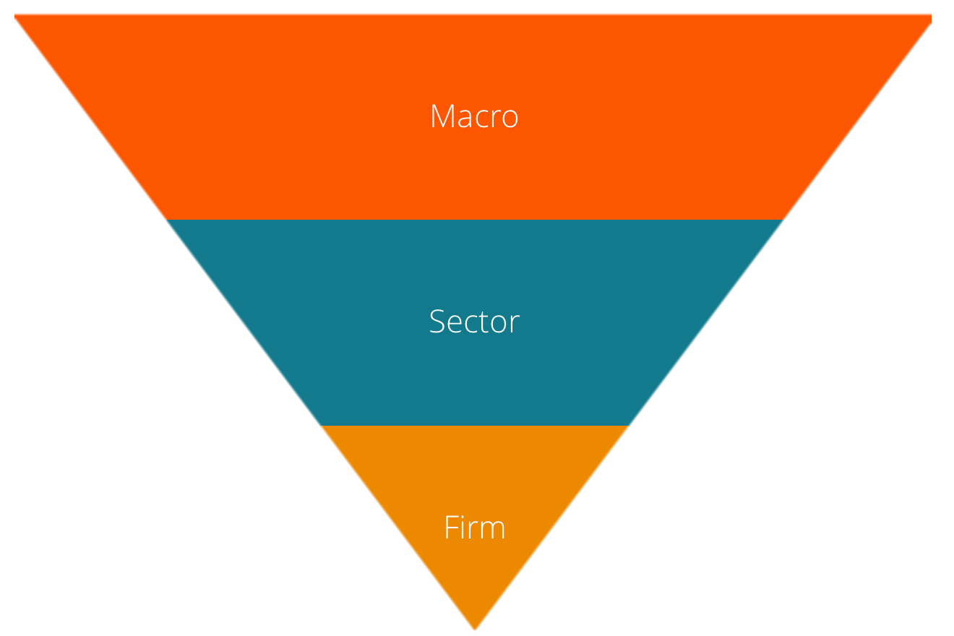
01. WHAT IS TOP-DOWN APPROACH?
A top-down approach is a problem-solving method that starts with the big picture and then breaks it down into smaller, more manageable parts.

Slide 4


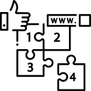
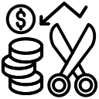
02.THE TOP-DOWN APPROACH ADVANTAGES AND DISADVANTAGE
ADVANTAGES
Decreased Risk
Strong Management
Good Organization
Minimized Cost

Slide 5




02.THE TOP-DOWN APPROACH ADVANTAGES AND DISADVANTAGE
DISADVANTAGES
Limited Creativity
Team disengagement
More of a strain on leadership
Slow Response to Challenges

Slide 6
03. WHEN TO USE THE TOP-DOWN APPROACH?
The problem is complex and needs to be broken down into smaller, manageable parts.
There is a need to understand the big picture before diving into details.
A clear understanding of the end goal is required before starting the project.
The solution can be divided into smaller subproblems that can be solved independently.

Slide 7
04. HOW TO APPLY THE TOP-DOWN APPROACH?
Step 2
Step 4
Step 1
Step 3
Manager-driven planning Develop a detailed action plan
Starting with a big-picture goal
Monitor and manage progress and evaluate results
Step 5
Set a clear overarching goal Break down the goal
Clearly communicate the plan so employees can understand

Slide 8
THANK YOU
I would like to send my sincere thanks to
Mr. Dao Vo, creator of the Journey to Your Best program. The program has helped me change myself, dare to challenge myself and rise. I wish you and the program to grow and continue to help many more people.

